Slide 1
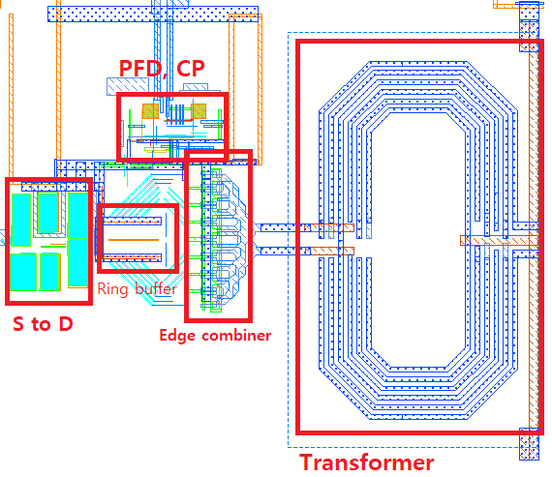
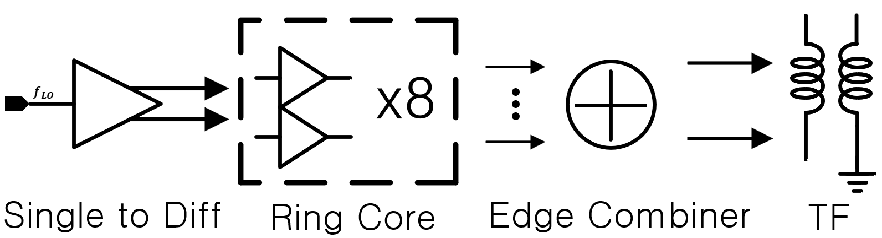
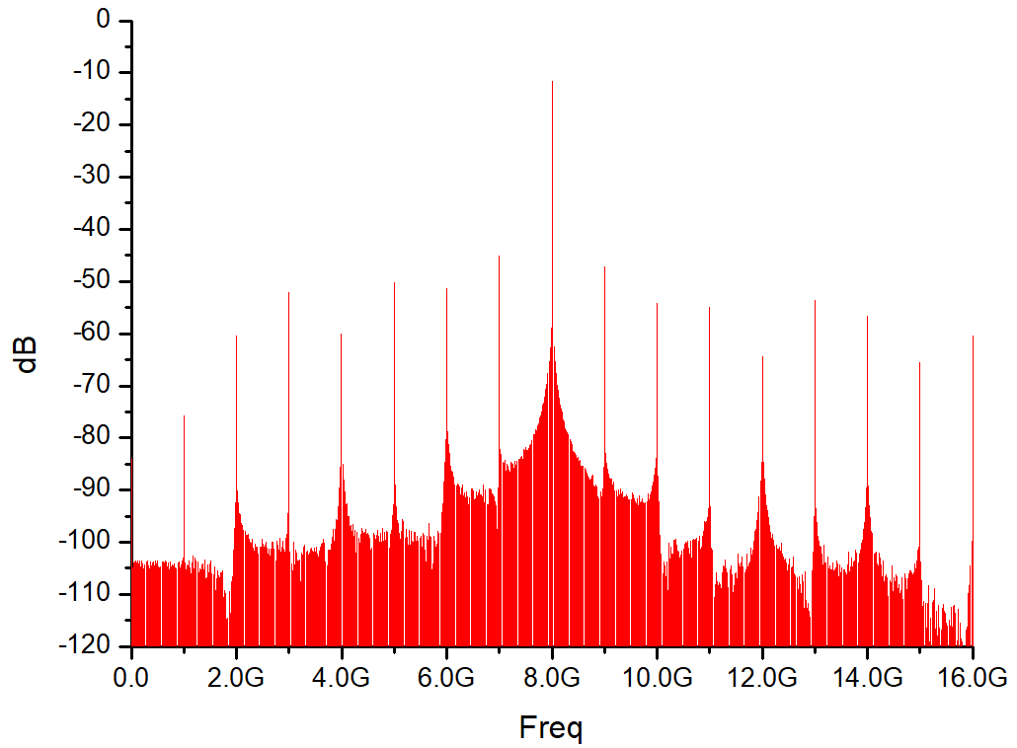
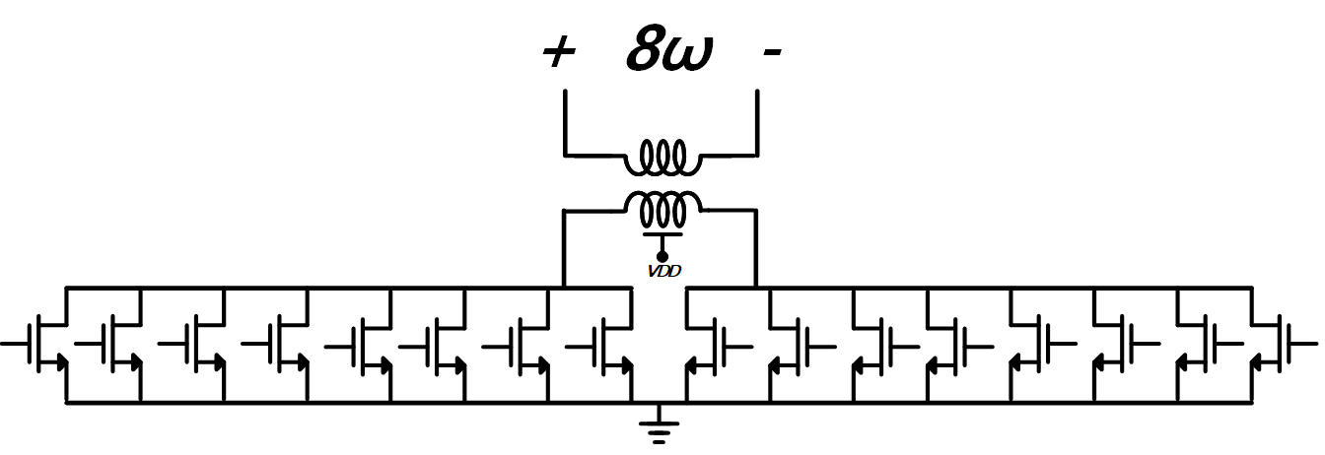
additional multiplier
Design of x8 Frequency-Multiplying DLL Using 65-nm CMOS Technology
Jae Hyun Park, Dong Yeol Yang, and Byung-Sung Kim
RF Microelectronic Design Lab., Sungkyunkwan University, Suwon 440-746, Korea
Abstract
This work presents frequency multiplying DLL using 65-nm COMS technology. This circuit is wideband frequency multiplier with multiplication ratio of 8 Waveform synthesized at a very low frequency about 1GHz for 8GHz output using direct digital synthesis (DDS).
I. Introduction
This work presents low frequency multiplier to drive W-BAND FMCW radar. This circuit is wideband frequency multiplier with multiplication ratio of 8, 1GHz to 8GHz . It was designed to make a W-BAND FMCW radar application assuming additional multiplier followed behind.
II. Description
The 1-GHz single-ended reference signal is converted to the differential signal through a differential amplifier. The differential signal is injected into one of the ring buffer cells to drive the inverter chain. A current staved ring buffer with eight cells is used to generate eight differential signals with T*3/8 time delay, i.e., 3π/8 phase offset. The 1-GHz voltage signals from the ring buffer are combined in the current domain by the adder amplifier. The adder is eight common-source (CS) differential amplifiers sharing the output load, as shown in Fig. 1(b).
III. Simulation Results
Fig. 2 show the chip photograph of the x8 multiplier. The overall chip size is 550 um * 600 um.
Fig. 3 shows simulation result, 8G output peak magnitude is -11dBm, and 35dBc compared to side spur
Figure 2. MDLL Layout without pad
(a)
(b)
Figure 3. Simulation result of output by 1G reference
Figure 1. MDLL block diagram (a), edge combiner (b)
IV. CONCLUSION
This paper demonstrated x8 multiplier for W-BAND FMCW radar using Samsung 65-nm CMOS. The multiplier occupies 550×600 um² with pad. The 8Ghz output magnitude is 11dBm, and 35dBc compared to side spur and power consumption is 13.4mW.
Acknowledgement
The chip fabrication and EDA tool were supported by the IC Design Education Center(IDEC), Korea.
This material is based upon work supported by the Ministry of Trade, Industry & Energy(MOTIE, Korea) under Development Program of Next-Generation Intelligent Semiconductor Technology (Design and Manufacturing). No.20009868, Development of 120GHz light-weight low-power Radar SoC for OMS(Occupancy Monitoring System).

